Slide 1




ITU AI/ML in 5G Global Challenge
Applying machine learning in
network extension optimization
Applying Machine Learning in Network Topology Optimization
No Boundaries
Gold Sponsor
Bronze sponsors
Organized by
GangZhouwei、RaoQianyin、XiLi、FengZezhong、GuoLin

Slide 2
1
Problem
2
Result
3
Evolution
4
Outlook

Slide 3
Background——Problem Introduction
Transmission is the vessel of Telecommunication. To construct a highly efficient network, each node should be used efficiently to form the transmission network. While the actual situation is not the case.
Ex: Kaili PTN network consists of 3191 nodes, 913 links
Low Load 483
High Load 82
Normal Load 348
Note: Kaili is one of the ten cities in Guizhou Province.

Slide 4
Background——Optimization problem
As the network becomes more complex, topology optimization cannot be fully completed. Only local adjustment or node expansion can be used to solve the high-load link problem and avoid affecting the business.
Possible Topologies=Nodes* Links
Ex: Kaili local network consists of 3191 nodes, 913 links
Possible Topologies =3191*913=
2,913,383
Impossible to fully analyze and optimize the network topology

Slide 5
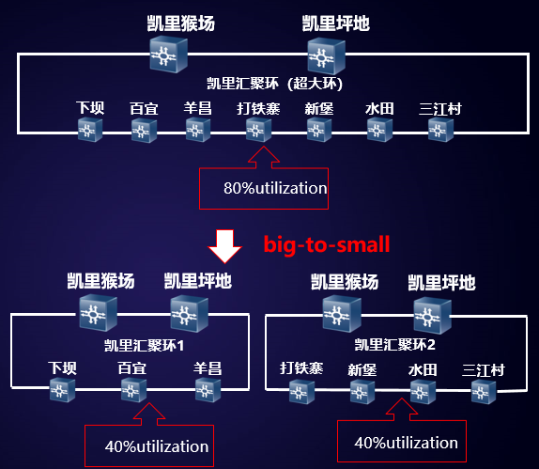
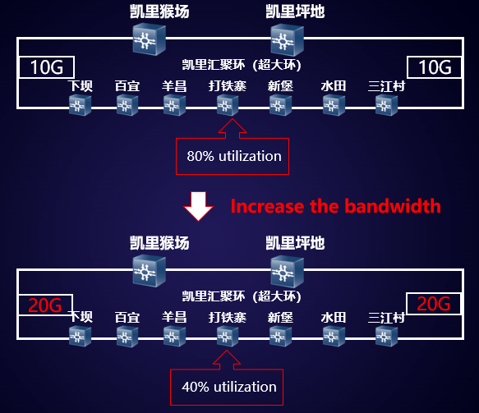
Background——Optimization problem
As the network becomes more complex, topology optimization cannot be fully completed. Only local adjustment or node expansion can be used to solve the high-load link problem and avoid affecting the business.
Solution1:Local（Link）Adjustment
Targeted "big-to-small" optimization for some links, reducing the number of nodes and load.
Solution2:Node Expansion
Increase the bandwidth of the link by upgrading hardware, and reduce link utilization.

Slide 6
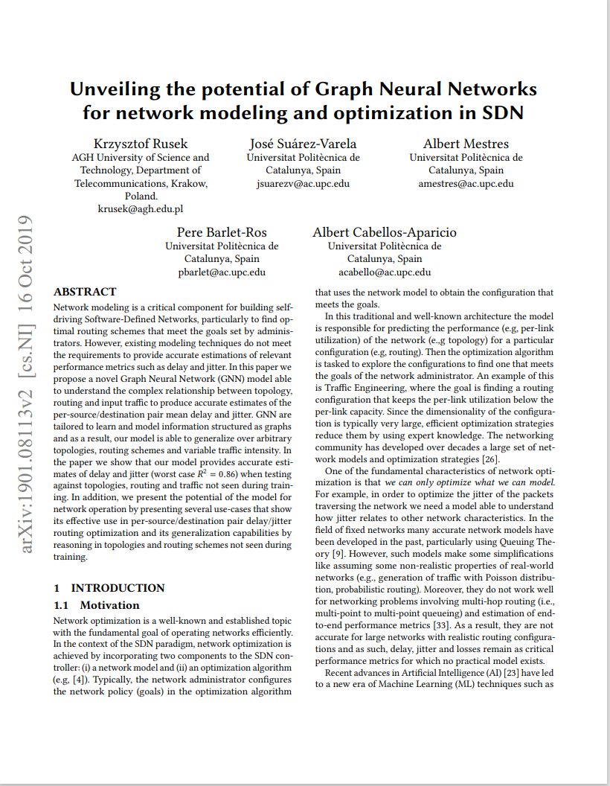
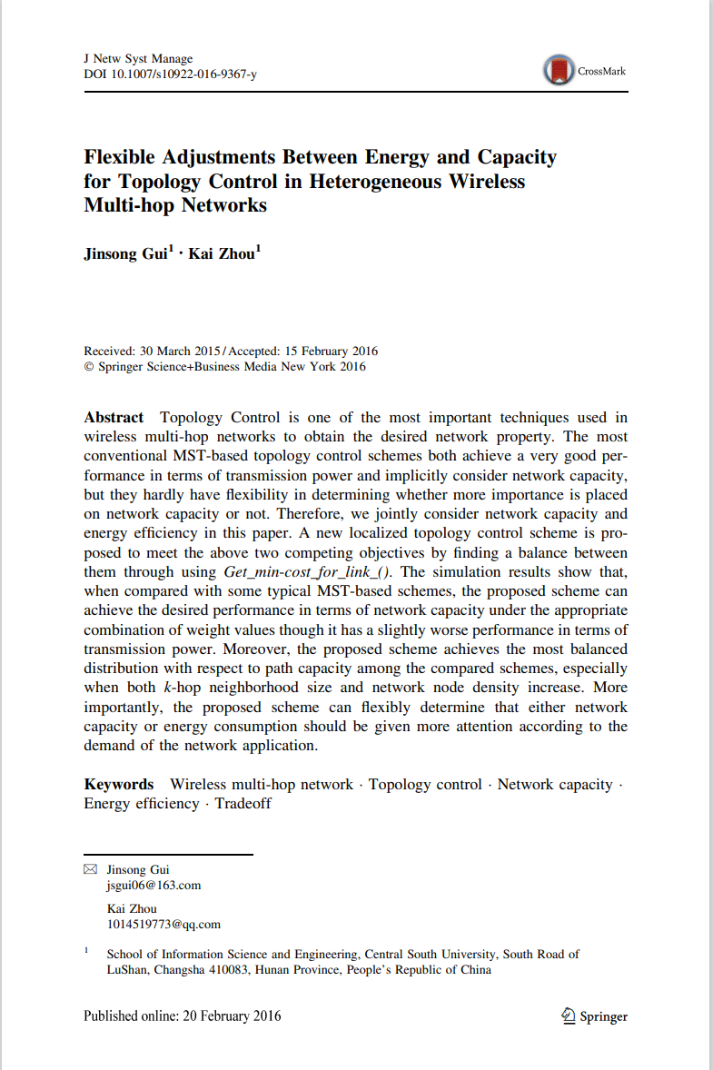
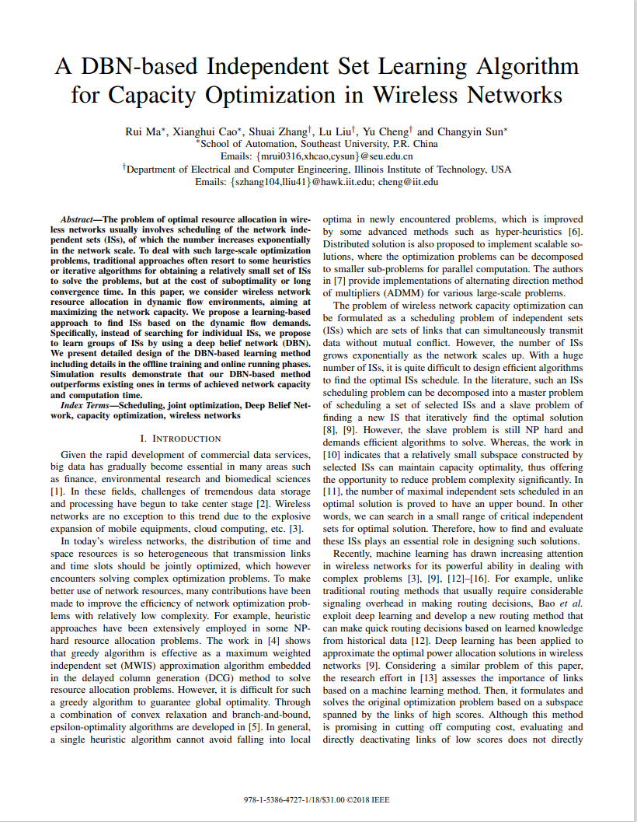
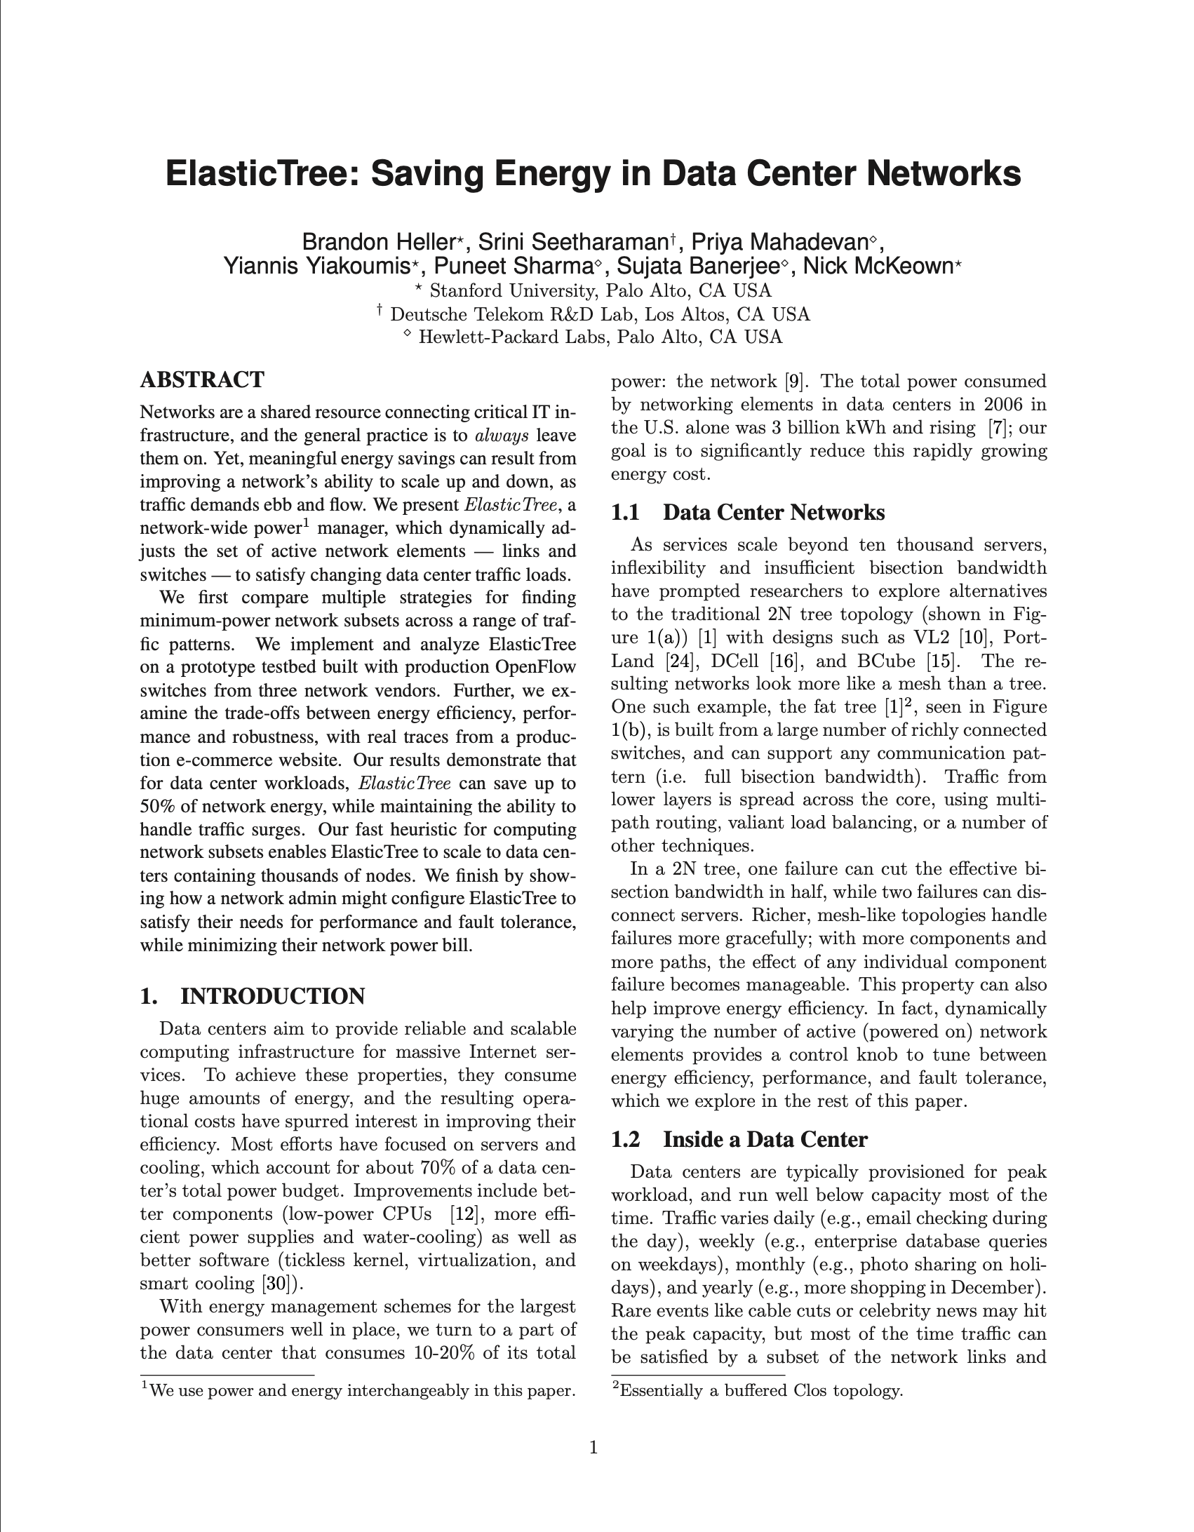

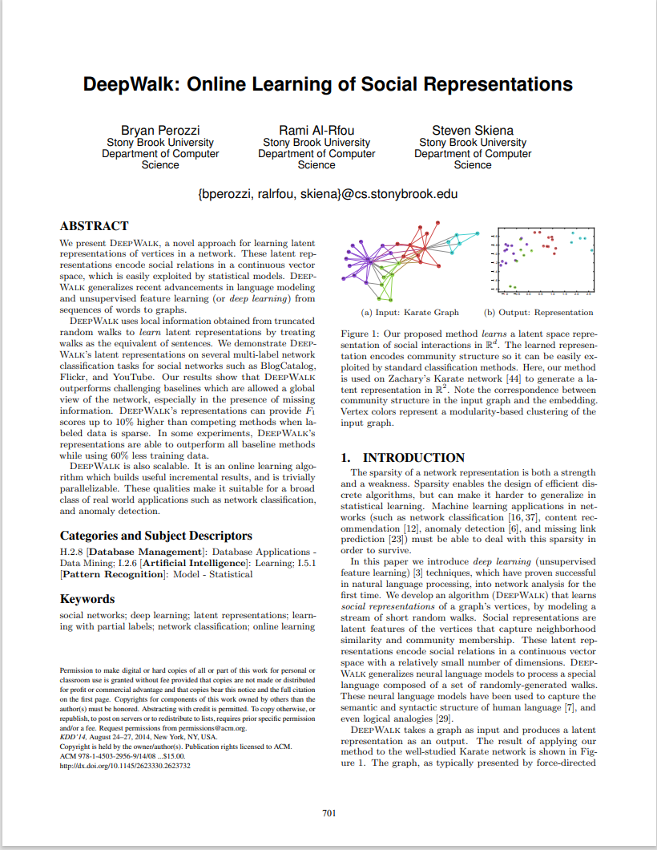
Background——Solution
Existing technologies and solutions cannot effectively solve the problem of network topology optimization. But it is enlightened that artificial intelligence can be used to complete topology optimization schemes.
SDN
1.《Unveiling the potential of Graph Neural Networks》
Wireless Network
1.《flexible adjustments between energy and capacity for topology control in hetreogeneous wireless multi-hop network》
2.《A DBN-Based Independent Set Learning Algorithm for Capacity Optimization in Wireless Networks》
Data Center Network
1.《ElasticTree_Saving_Energy_in_Data_Center_Networks》
2.《Understanding and Mitigating Packet Corruption in data center networks》
Internet
1.《DeepWalk: Online Learning of Social Representations》
Notes:
为解决上述问题，我们查询了很多参考文献，其中传输新技术的SDN更注重解决延迟，缺少拓扑优化指导。网络拓扑优化方案中，有无线网、数据中心和互联网场景，无线网的局限在于属于网络末端拓扑调整，与传输网全连接方式不一样。数据中心和互联网场景中节点数比起传输网不是一个量级，无法使用。但是我们从这些文献中得到启示，可以尝试运用人工智能将拓扑优化方案交由机器完成，通过智能化运维提升网络资源利用率。

Slide 7
1
Problem
2
Result
3
Evolution
4
Outlook

Slide 8
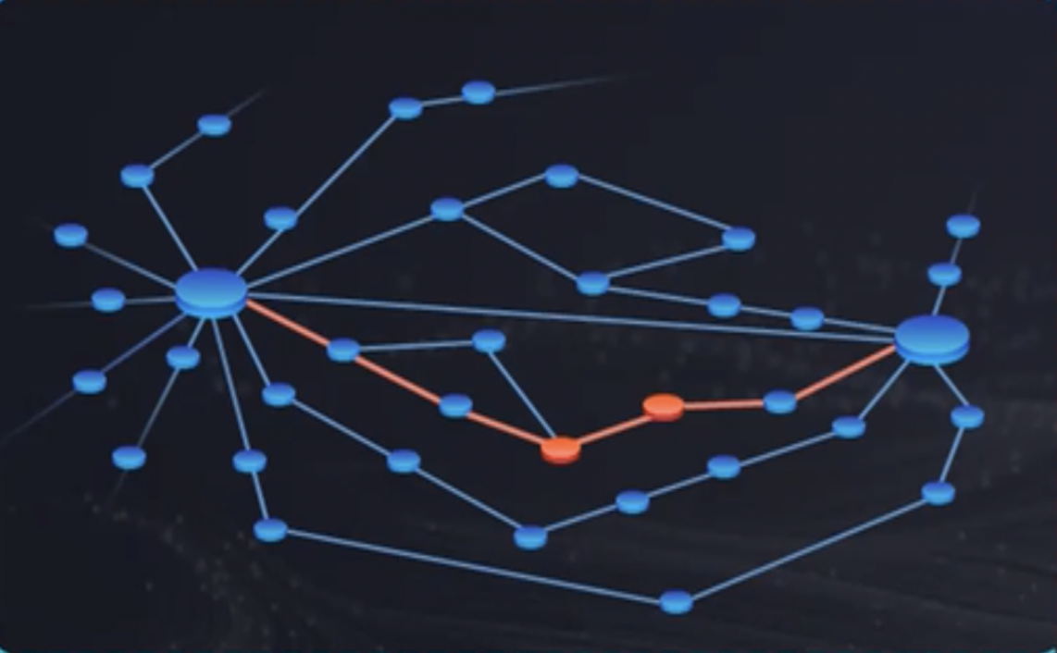
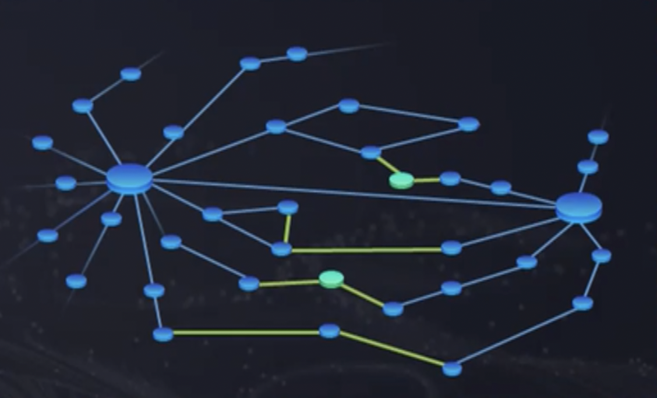
Ideas——Problem Analysis
The problem is based on real data on the live network, allowing developers to simulate and automatically optimize the network topology.
Now
Future
optimize
2000 Nodes
Previous Traffic
Topology
Latitude and Longitude
Recommendation ITU-T Y.3172
ML Pipeline Subsystem
ML Management Subsystem
ML Sandbox Subsystem
ML underlay networks
SRC
C
PP
M
P
D
SINK

Slide 9
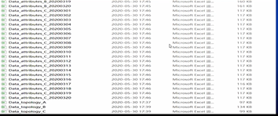

Development——Architecture Design
The design result mainly includes three parts: preprocessing, model and policy.
ML pipeline
ML underlay networks
Data handling reference point
SRC
C
PP
M
P
D
SINK
RAW Data
1 Topology+20 Node Attributes
DPP
TRM
TOP
input
output
Design
30
Result Data
TFM
Data Pre-Processing：
Data cleaning for subsequent operations
Topology Restore Model：
Restore the topology of the current network
Traffic Forecast Model：
Forecast node traffic based on changes
Topology Optimization Policy：
balanced the load by optimizing the topology

Slide 10
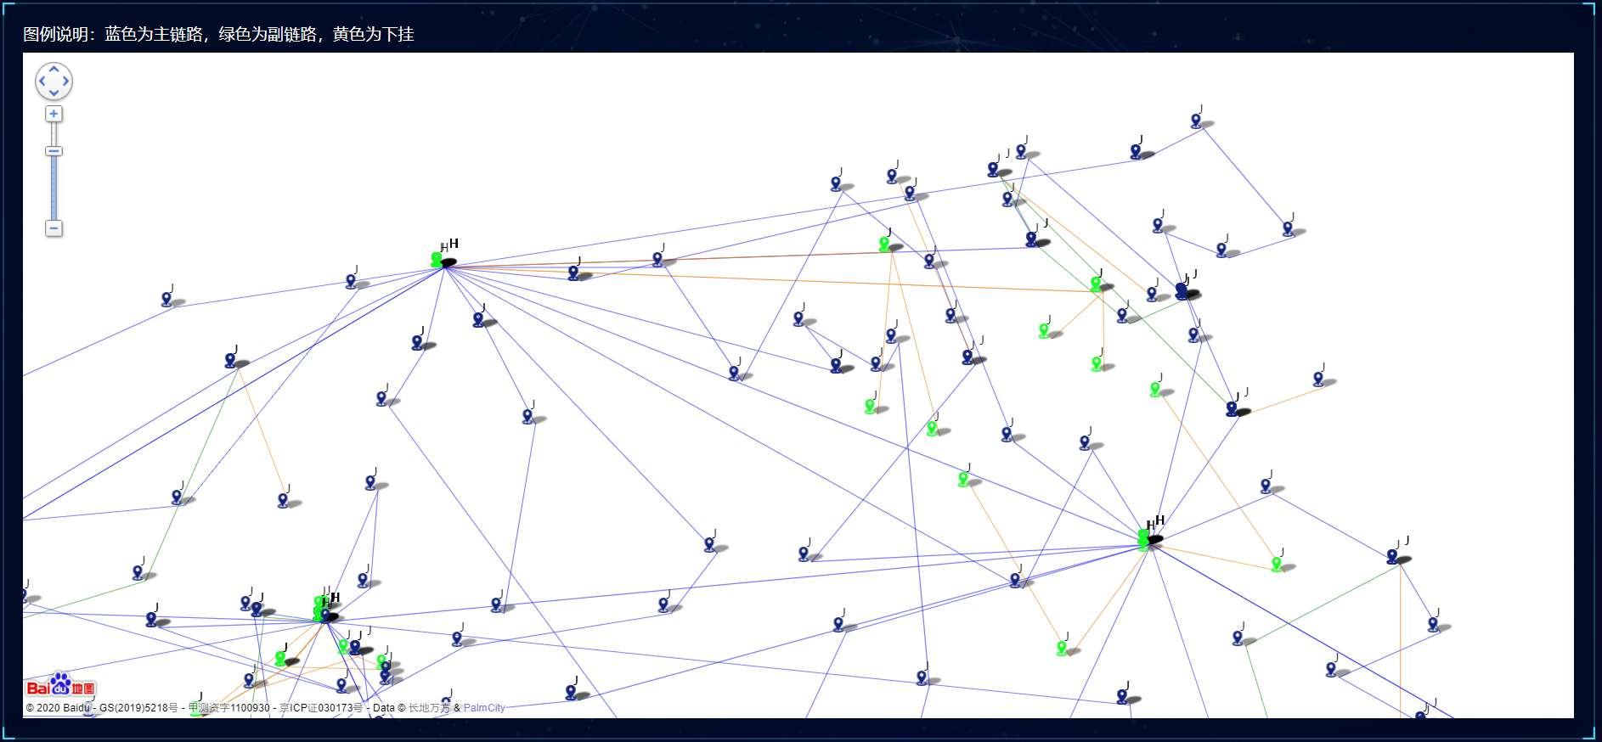
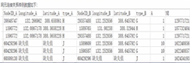

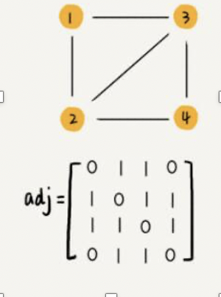
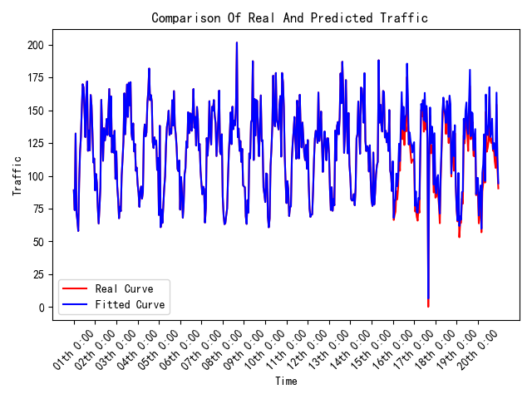
Development——Achievement Exhibition
Preprocessing, model and policy, with unique advantages.
Provided Data
Python+pandas+Tensorflow
Topology diagram by Qunee
Network Topology
TRM
TOP
DPP
RAW Data
1 Topology
+
20 Node Attributes
Design
Node Attributes
Location and Traffic
TFM
Data Pre-Processing
Topology Restore Model
Traffic Forecast Model
Adjacency matrix；
Pandas；
Mark nodes；
BFS；
Innovation：
the BFS search node can be accessed repeatedly to adapt the search of the link set
LSTM；
Innovation：
1、Model each node and make predictions separately
2、 Each neuron carries 24 traffic data

Slide 11
Development——Achievement Exhibition
Preprocessing, model and policy, with unique advantages.
Topology Optimization Policy
Overloaded Links
L1
J2
J3
J2
J3
J1
J1
G3
G3
G1
J7
G1
J7
J6
J6
J8
L3
L2’
J8
L3’
L2
J5
J5
G2
J4
J9
G4
G2
J4
J9
G4
High Load
Normal Load
Low Load
1、optimize overloaded links
2、optimize low-load links
3. Adjust the threshold and perform step 1 and step 2 again
4. Perform step 3 again
5. Finish
threshold | overloaded | low-load
1 | >2*𝜇 | <0.2*𝜇
2 | >1.6*𝜇 | <0.4*𝜇
3 | >1.4*𝜇 | <0.6*𝜇
𝜇=Average link utilization of the entire network

Slide 12
Development——Achievement Exhibition
Preprocessing, model and policy, with unique advantages.
Topology Optimization Policy
Low-load links
L1
J2
J1
L1’
J2
J1
G2
G2
J4
L2
J6
J9
J6
J9
G1
J3
G1
J3
J4
J5
J5
L3
J7
J8
L3’
J8
J7
High Load
Normal Load
Low Load
1、optimize overloaded links
2、optimize low-load links
3. Adjust the threshold and perform step 1 and step 2 again
4. Perform step 3 again
5. Finish
Innovation：
Aggregate low-load links with the same head and tail nodes

Slide 13
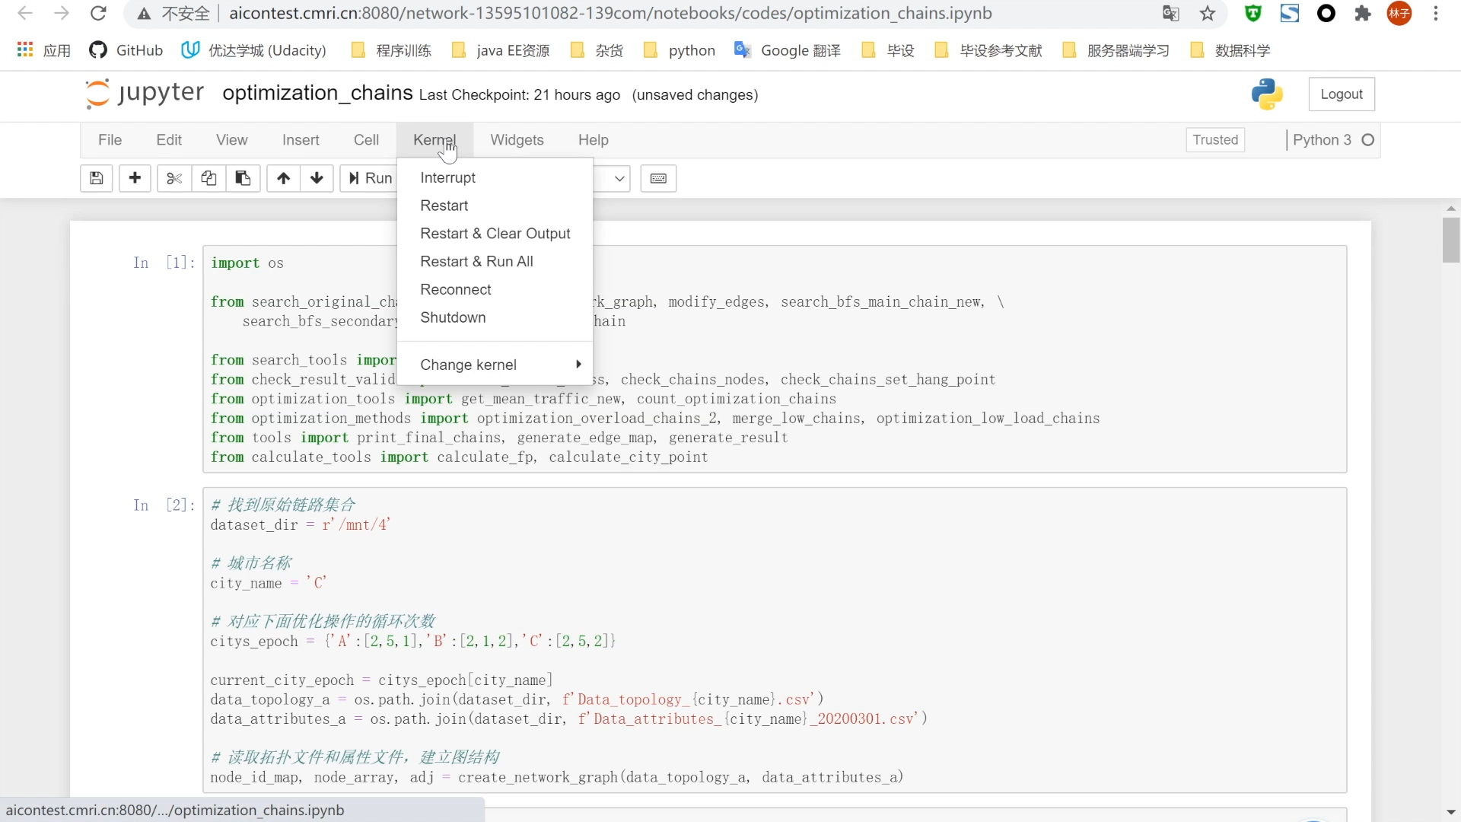
Results——Video Demo
A video demo for our project.

Slide 14
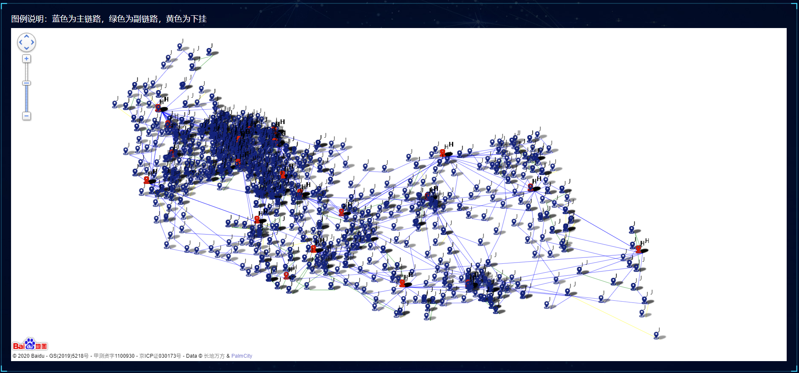
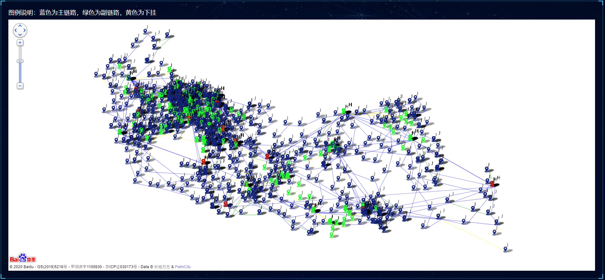
Results——Achievement Exhibition
The Algorithm automatically completed the topology optimization plan of City C in 10 minutes and obtained 44.55 points
Original Topology
Optimized Topology
Green for optimized nodes

Slide 15
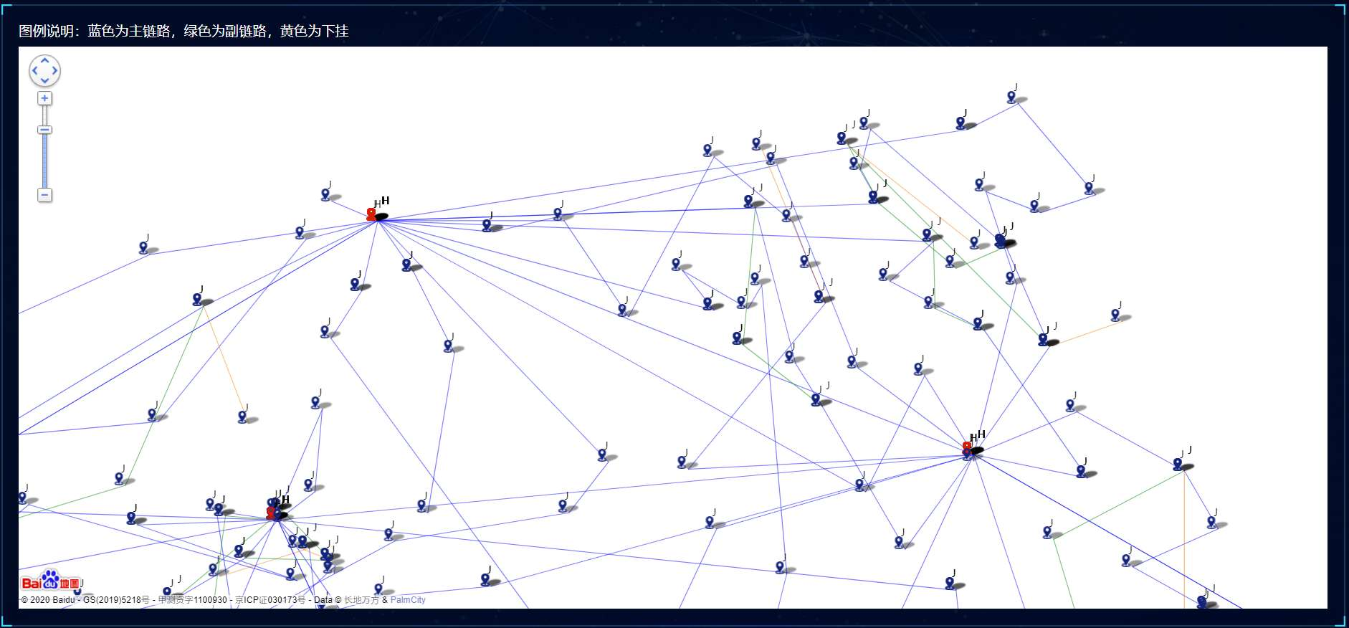
Results——Achievement Exhibition
The Algorithm automatically completed the topology optimization plan of City C in 10 minutes and obtained 44.55 points
Original Topology（ Zoomed view）
Optimized Topology（ Zoomed view）
Green for optimized nodes

Slide 16

Results——Feedback
In the finals, the host highly affirmed the results and awarded us the first prize.
Advantage
Result
1. Many special situations are considered in the traffic forecast, and the thinking is comprehensive。
2. Advantages in topology restoration, and a unique topology optimization policy has been established.
3. For data preprocessing, adjacency matrix is applied to store the connection relationship for faster query speed. The idea of using the average value to complete the missing data solves the inconsistency between the actual and ideal.
4. Good model generalization, robustness and practicability.
5. Propose an innovative approach suitable for link set search.
First prize in the final
Advice
1. Improve traffic forecast with more features
2. Improve optimization policy with mature algorithms
3. Using docker capability encapsulation
4. Verify the effect through pilot project

Slide 17
1
Problem
2
Result
3
Evolution
4
Outlook

Slide 18
Improvement——Traffic Forecast
Advice： Improve traffic forecast with more features
TRM
TOP
Network Topology
DPP
RAW Data
1 Topology
+
20 Node Attributes
Node Attributes
Location and Traffic
TFM
Solution
Result
Add 3 features:
1. Time dimension: add features of weather, working days/rest days;
2. Spatial dimension: increase the traffic characteristics of surrounding nodes;
Average forecast accuracy increased by 3.6%
Notes:
我们团队最终得分为44.55分，排名第二。

Slide 19
Improvement——Optimization Policy
Advice： Improve optimization policy with mature algorithms
TRM
TOP
Network Topology
DPP
RAW Data
1 Topology
+
20 Node Attributes
Node Attributes
Location and Traffic
TFM
Solution
Result
The greedy algorithm is used to optimize the topology, and the node is moved based on the highest evaluation index score.
 | J1 | J2 | J3 | J4 | ……
L1 | 0.4618 | 0.5026 | 0.5185 | 0.5531 | ……
L2 | 0.4767 | 0.5345 | 0.5567 | 0.5732 | ……
L3 | 0.5068 | 0.5123 | 0.5234 | 0.5613 | ……
The link optimization ratio increased 11%
Notes:
我们团队最终得分为44.55分，排名第二。

Slide 20


Improvement——Model encapsulation
Advice： Using docker capability encapsulation
CI/CD:k8s , gitlab , docker regrstry
M
L
FO
TRM
TOP
Capability Encapsulation
TRM
Capability
TFM
Capability
TFM
TOP
Capability
Solution
Result
Capability scheduling、Self-healing、Horizontal Expansion and Data Sharing
1. MLFO shortens development time by 70%
2. Data sharing reduces storage consumption by 50%
3. Service self-healing reduces failure to affect business by 80%
Web Interface、Virtualization、CI/CD

Slide 21
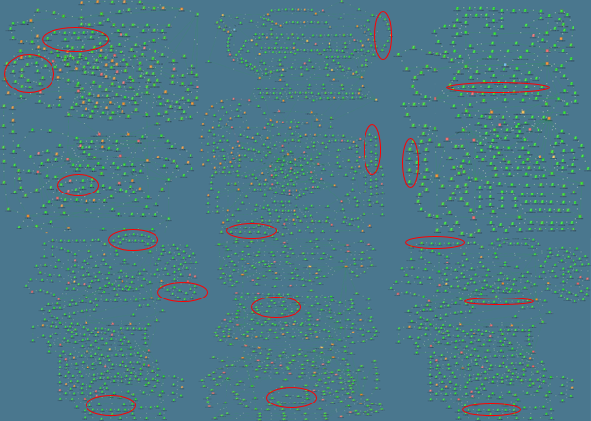
Improvement——Verify in Production
Choose Kaili City for the pilot city. We Solve 16 high-load link with the help of this technology.
Kaili PTN Network：3191 Nodes，913 Links
Plan | Traditional Plan | AI Plan
Construction Cost | ￥3.05M | ￥0.45M
Human Input | 21 Man-Days | 4 Man-Days
Low-load links | 40 | 3
Threshold crossing links | 5 | 0
Capacity (day) | 102T | 181T

Slide 22
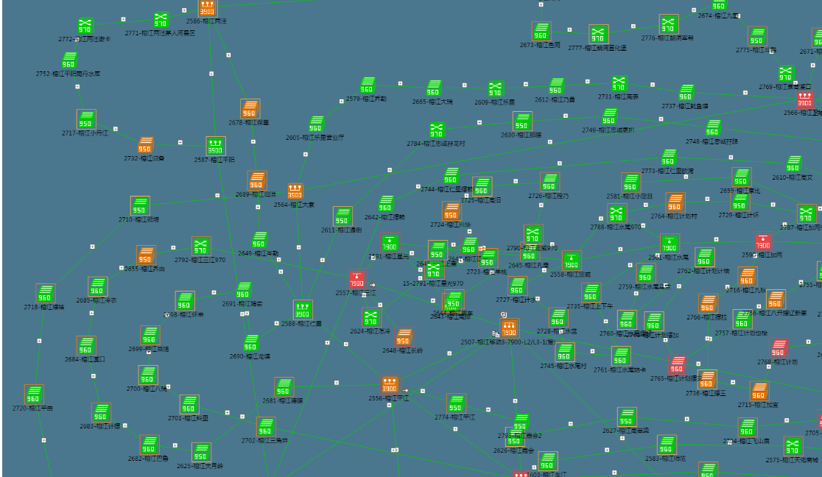
Improvement——Verify in Production
Choose Kaili City for the pilot city. We Solve 16 high-load link with the help of this technology.
Link 1 and Link 10：
Link 1 and Link 10 optimization:
Note：00:00-01:00 is time for optimization

Slide 23
1
Problem
2
Result
3
Evolution
4
Outlook

Slide 24
Outlook——Evaluation
Recommendation ITU-T Y.3173
Future network intelligence level assessment framework including IMT-2020
Basis of Evaluation ：Y.3173 P12，Table 7-1
Network intelligence level | Dimensions
 | Action implementation | Data collection | Analysis | Decision | Demand mapping
L0 | Human | Human | Human | Human | Human
L1 | H&S | H&S | Human | Human | Human
L2 | System | H&S | H&S | Human | Human
L3 | System | System | H&S | H&S | Human
L4 | System | System | System | System | H&S
L5 | System | System | System | System | System
Demand mapping ：
Demand mappings are done by human, so the rating is Human.
Decision ：
The topology optimization scheme given by the system needs people to evaluate and verify, and then decide whether to implement it, so the rating is H&S.
Analysis ：
Data analysis requires people to choose specific analysis algorithms and analysis rules, and cannot be automatically selected and constructed by the system, so the rating is H&S.
Data collection ：
Data collection requires people to define fields and collection rules, and then the system automatically collects them, so the rating is H&S.
Action implementation :
Transmission topology optimization involves optical cable splicing. In the case of link disconnection, it can be realized through system use cases. In the case of link establishment, it is a manual operation, so it is rated as H&S.
Dimensions |  |  |  |  | Overall network intelligence level
Action implementation | Data collection | Analysis | Decision | Demand mapping
Human | Human&System | Human&System | Human&System | Human&System
L1 | L2 | L3 | L3 | L3 | L1
Notes:
从扩展性上说，可以扩展输入，提升预测准确性和优化效果，也可以扩展输出，用于更多设备预测或更多预测场景。从技术上说，软件方面开源且便于部署。而且成果用于更多城市。从应用上说，可以广泛用于现网网络规划工作，从而支撑即将来临的5G大发展。

Slide 25





Outlook——5G、 Ecosphere 、AItoB
5G
The combination of communication maintenance and AI can accelerate the promotion of complex 5G network.
Only for
For
everything
Ecosphere
In China Mobile, an ecosystem of people + platform + standards has been formed.
New Tech
ISP screening
Platform Update
Platform defect
Developer
Platform
Standards
AItoB
AItoC：
To meet people’s needs and meet people’s living and working habits.
AItoB：
To meet enterprises' needs with corporate standards and processes.
This study will provide an example for the AItoB model.

Slide 26


END
Thanks
Notes:
谢谢各位聆听。

Slide 27
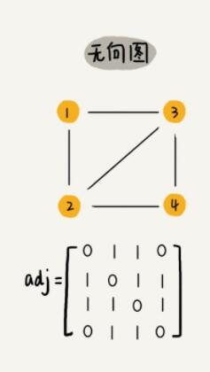
Appendix——Data Preprocessing
The data given is based on nodes, and the node connection relationship is used for network topology restoration, and needs to be converted into a suitable data structure for storage and then convenient for subsequent recalls. Node attributes (traffic and latitude and longitude) are used for topology optimization after traffic forecast. Whether it is possible to create a new link requires checking the integrity of key fields and processing the missing data to ensure subsequent forecast and optimization.
Data Processing:
Process data through pandas to ensure data integrity.
Latitude and longitude missing:
Mark the node specially.
Network Topology
DPP
Data Cleaning
RAW Data
1 Topology
+
20 Node Attributes
Adjacency Matrix:
Pros: Simple storage and efficient query.
Cons: High storage consumption.
Adjacency List:
Pros: Low storage consumption.
Cons: Inefficient query.
Node Attributes
Location and Traffic
Storage Structure

Slide 28
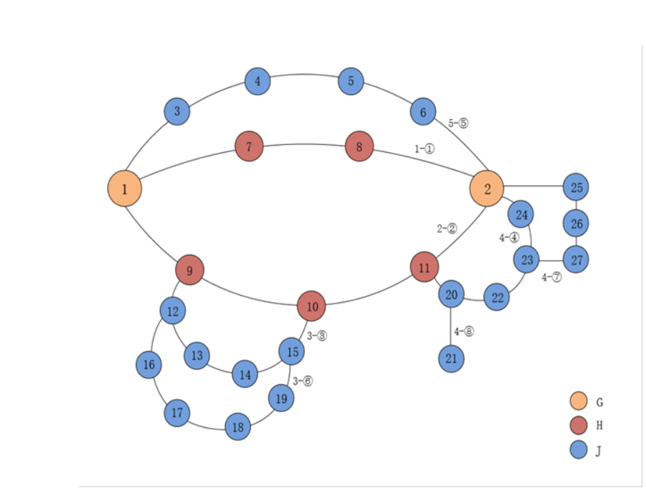
Appendix——Algorithm Selection（BFS）
Data processing converts binary connection relationships into graph representations, so topology restoration is a graph search problem. The most commonly used search algorithms for graphs are BFS and DFS. Due to certain requirements for convergence time, the breadth-first search algorithm is adopted.
BFS
Adopted
DFS
Advantages:
1. The shortest path problem can be solved, and the processing efficiency is high
2. Each node is accessed only once, and is always accessed with the shortest path to facilitate link identification.
Disadvantages:
Large memory overhead (requires a large number of array elements to store state)
Advantages :
1. Easy to find all connections
2. A single link is searched one by one, which takes up relatively fewer memory.
Disadvantages:
1. It is time-consuming to traverse multiple times, search all possible paths, and cancel after marking.
2. The efficiency is not high when the search depth is large.
③
①
②
①
②
③③
③
④
explores all of the neighbor nodes at the present depth prior to moving on to the nodes at the next depth level.
explores as far as possible along each branch before backtracking.

Slide 29
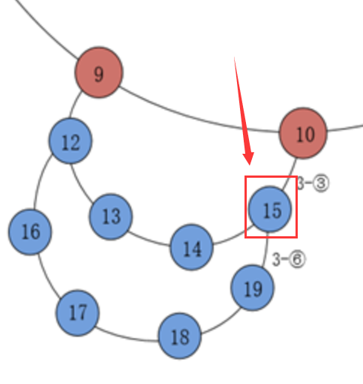
Appendix——Innovation of BFS
In BFS algorithm, the nodes that have been visited cannot be visited again, but there are situations in which nodes may be visited multiple times in the link. Therefore, based on the traditional BFS design algorithm, we modify the search state to make the algorithm adapt to the search of the link set.
BFS：
Assuming that the main link is searched from [9] node, it must be 9-12-13-14 that this main link first encounters the [15] node, causing 9-12-16-17-18-19 to be unable to access the [15] node , Only one main link 9-12-13-14-15-10 was found, and the longer main link 9-12-16-17-18-19-15-10 was lost.
Our Algorithm：
Assuming that the main link is searched from the node [9], when it encounters the node [15], no access restrictions will be made to it, so at the end two main links will be searched, 9-12-13-14-15- 10 and 9-12-16-17-18-19-15-10. This situation of intersecting main links will be resolved later, and the longer main link, will be reserved.
√
╳

Slide 30
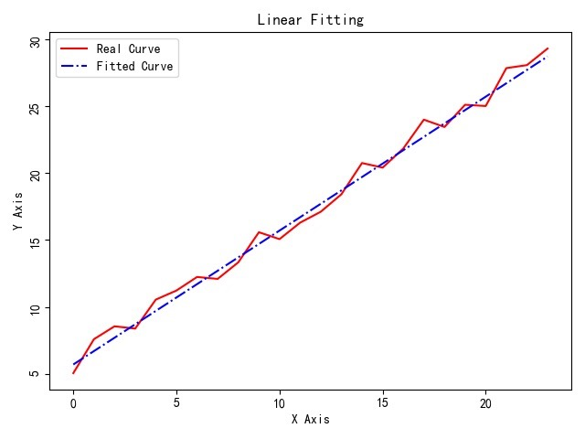
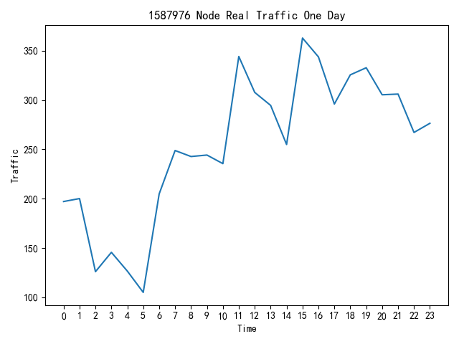
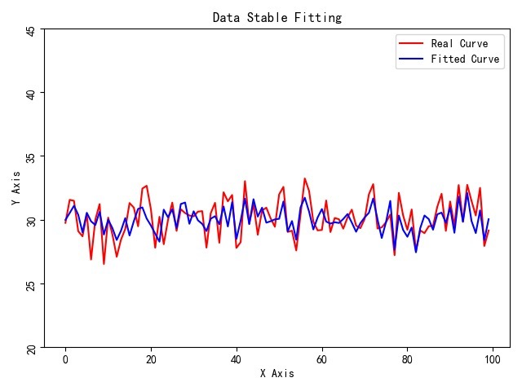
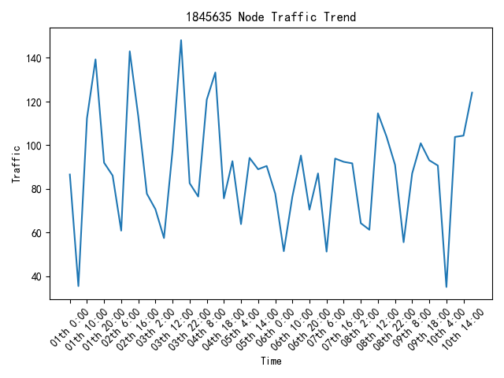
Appendix——Algorithm Selection（LSTM）
The mainstream time series forecasting algorithms include multiple linear regression, ARIMA, and LSTM. Through analysis, the data is almost non-linear and the data fluctuates. Among the commonly used forecasting models, the LSTM model is designed with a special structure to remember and filter the traffic on the time scale, so Use LSTM.
Ideal Data
Actual Data
Adopted
Multiple linear regression:
Advantages：
Low complexity; fast training speed；
Disadvantages：
Data trend is required to be stable; Accuracy is not excellent;
LSTM：
Advantages ：
Not susceptible to data fluctuations;
High accuracy; forget gate remembers important timing information;
Disadvantages ：
High complexity;
Slow training speed;
ARIMA：
Advantages ：
Moderate complexity; average training speed;
Disadvantages ：
Data trend is required to be stable;
Low accuracy when data fluctuates

Slide 31
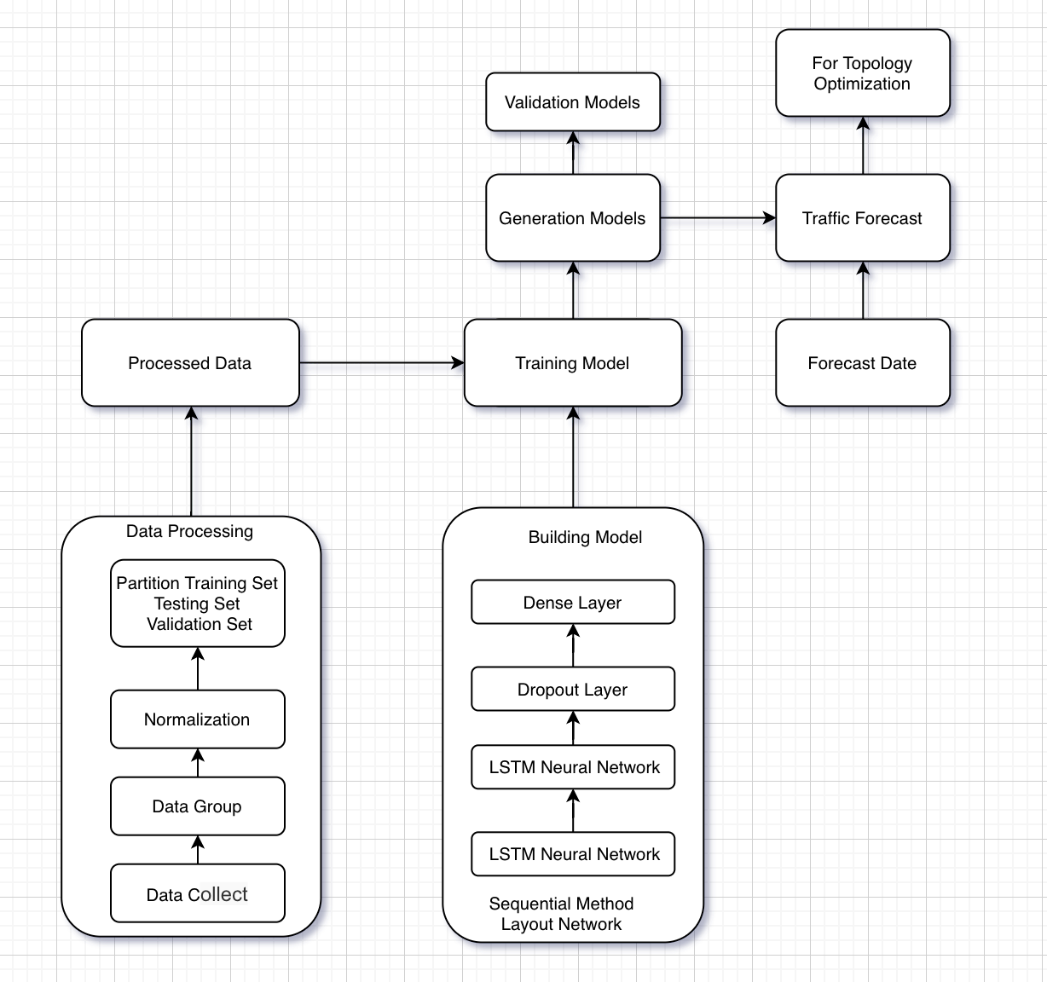
Appendix——Innovation of LSTM
If only one model is used for prediction, the accuracy is difficult to improve. Modeling each node and predicting separately will greatly improve the accuracy.
Usually, each neuron only transmits one traffic value, and it is changed to carry 24 traffic information each time to fit more traffic changes and improve accuracy.
Original input:
[[244],[197],[195],[180],[375],[375],[341],[341],[97.3],[88.5],[140.4],[140.4],[109.2],[109.2],[94.4],[59.9],[59.9],[73.1],[88.6],...]
Raw Data：
244,197,195,195,180,375,375,341,341,97.3,88.5,140.4,140.4,109.2,109.2,94.4,159.9,159.9,73.1,88.6,88.6,60.6,51.1,52.6]
Current input:
[[244,197,195,195,180],[197,195,195,180,375],[195,195,180,375,375],[195,180,375,375,341],[180,375,375,341,341],...]

